Slide 1
Rockbuster stealth llc
Puneet Badwal

Slide 2
About RockBUster
Rockbuster Stealth has been a global leader in the movie rental service. With a changing climate into the movie rental business, Rockbuster wants to launch a new data driven strategy by leveraging its current movie license and moving more towards an online platform to compete with Netflix and Amazon Prime in the industry

Slide 3


Key Questions and objectives
What are some of the movie rental statistics (rental rate, cost, duration)?
Which countries are Rockbuster customers located in?
Which movies contributed the most/least to revenue gain?
Sales figures by region/country
Which genres and ratings of movies had the most success?

Slide 4
Current movie rental statistics
Minimum
Rental Duration: 3 Days
Rental Rate: .99¢
Average
Rental Duration: 5 Days
Film Length: 115 Minutes
Maximum
Rental Duration: 7 Days
Rental Rate: $4.99
Replacement Cost: $9.99
Film Length: 46 Minutes
Rental Rate: $2.98
Replacement Cost: $19.98
Film Length: 185 Minutes
Replacement Cost: $29.99
Rockbuster offers 1000 titles in over 100 countries. With a vast library of titles to offer, replacement of some movies can be costly (Maximum of $30). Some titles are longer in length and could result in a longer rental duration, which leads to more sales.

Slide 5

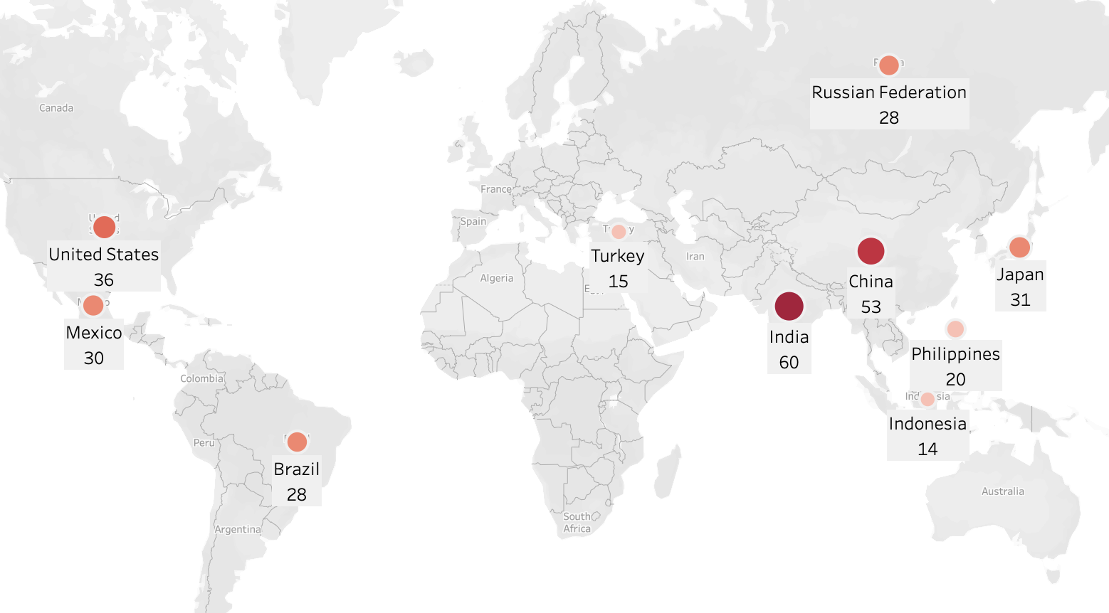
Where are rockbuster’s customers?
This map illustrates the top 10 countries with the most customers for Rockbuster
India, China and the US take the top 3 spots in terms of customer base
There is a strong Asian customer base, as 7 of the top 10 countries are located in Asia (Turkey and Russian Federation inclusive)

Slide 6
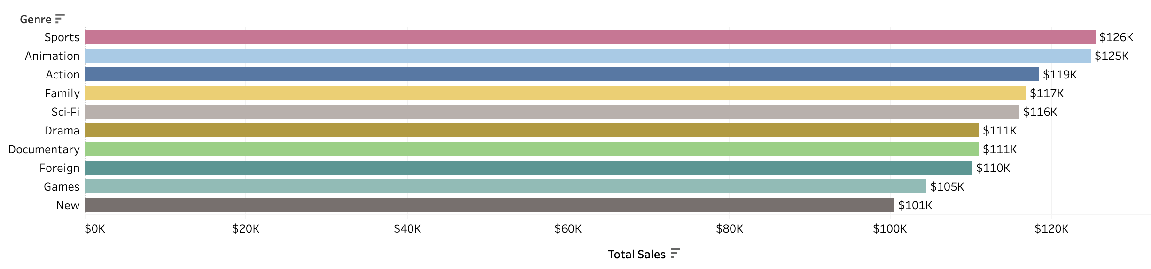
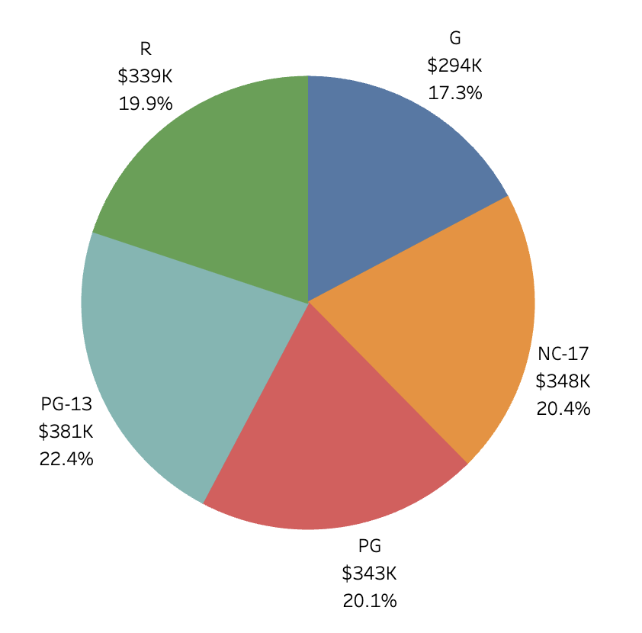
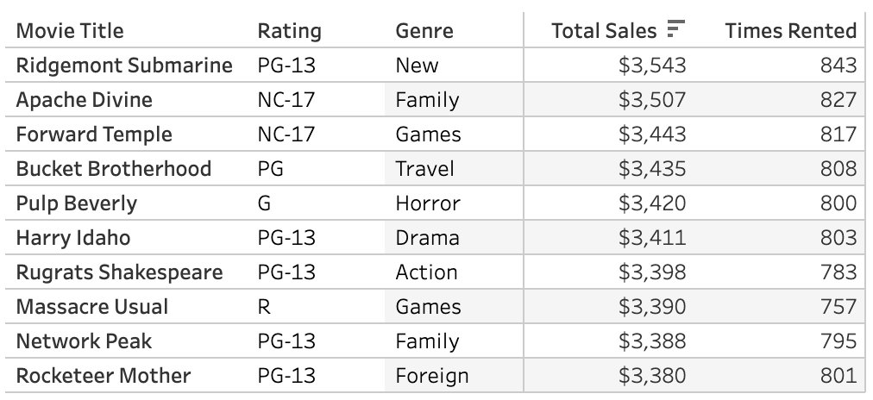
Top titles, genres, and ratings
Movie Ratings
Top 10 Genres
Top 10 Titles
The Sports, Animation, and Action genres produced the most sales from the Rockbuster library
There is a relatively even distribution between the 5 MPAA ratings, with a slight edge going to PG-13 movies making the most sales
While only 1 movie (Rugrats Shakespeare) falls under one of the top 3 genres (Action), 50% of the top 10 movies are rated PG-13

Slide 7
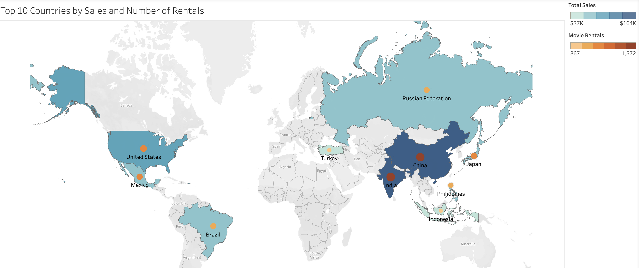
Most profitable countries
The top 3 countries with the most rentals and profits are India, China, and the US, all with over $100K in sales and over 950+ total rentals. These same 10 top profitable countries, are the same 10 countries with the most customers

Slide 8
Insights and Recommendations
India, China, and the US lead the way in terms of strongest lifetime customer base. These 3 countries should be the primary focus for all future campaigns and planning for new releases and promotions
1
More marketing efforts and resources should be tailored around Asian countries as well, because 7 of the top 10 most profitable countries are in Asia
2
Rockbuster might consider acquiring more titles in the Sports, Animation, and Action genres, and those that are rated PG-13 as well. These are the most rented and popular types of titles from a global perspective.
3
Rockbuster should also invest in technologies for streaming their titles since they already have licensing to their movies. This will ensure they can compete with other streaming services like Netflix and Amazon Prime.
4

Slide 9
Tableau Storyboard Link

Slide 10
END

